Slide 1

PIZZA SALES ANALYSIS
USING MYSQL

Slide 2

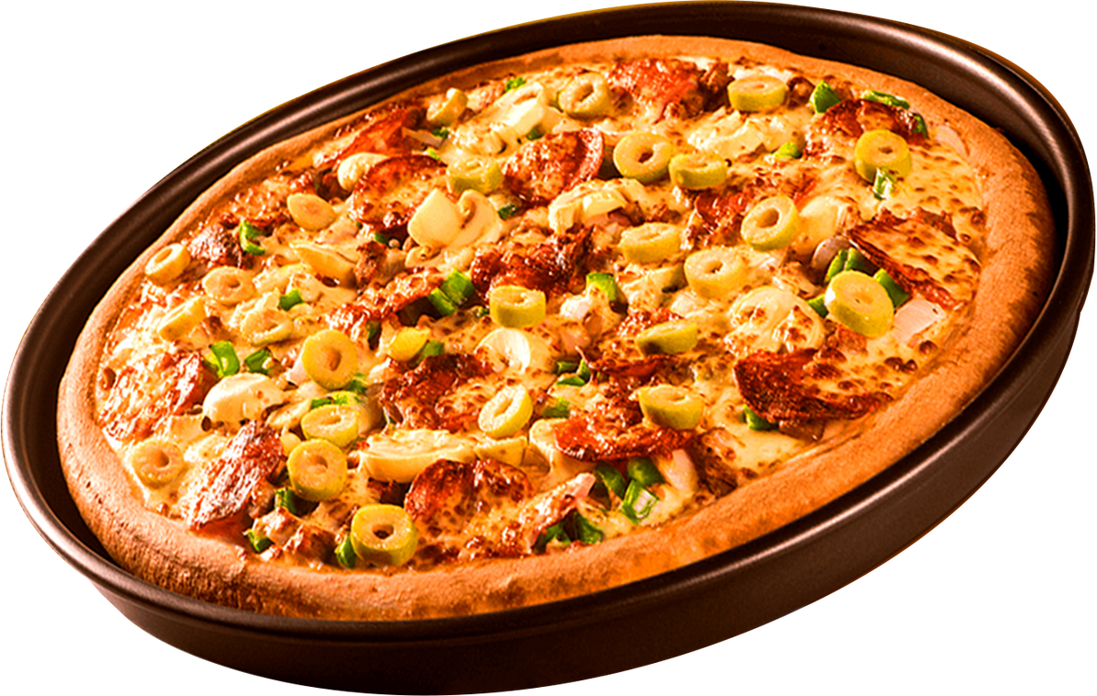


In this Pizza Sales Analysis project, I undertook an in-depth analysis of pizza sales data using MYSQL . Leveraging four comprehensive datasets, I explored critical aspects of the business by answering 13 strategic questions. This analysis revealed valuable insights into:
Sales growth trends and patterns over time
Customer preferences and top-selling pizzas
Operational efficiency in meeting customer expectations
These findings provided a clear view of the business's overall performance, deepened our understanding of customer behavior, and highlighted key opportunities for future growth in the pizza industry.

Slide 3
Questions
Retrieve the total number of orders placed.
Calculate the total revenue generated from pizza sales.
Identify the highest-priced pizza.
Identify the most common pizza size ordered.
List the top 5 most ordered pizza types along with their quantities.
Join the necessary tables to find the total quantity of each pizza category ordered.
Determine the distribution of orders by hour of the day.
Join relevant tables to find the category-wise distribution of pizzas.
Group the orders by date and calculate the average number of pizzas ordered per day
Determine the top 3 most ordered pizza types based on revenue.
Calculate the percentage contribution of each pizza type to total revenue.
Analyze the cumulative revenue generated over time.
Determine the top 3 most ordered pizza types based on revenue for each pizza category.

Slide 4
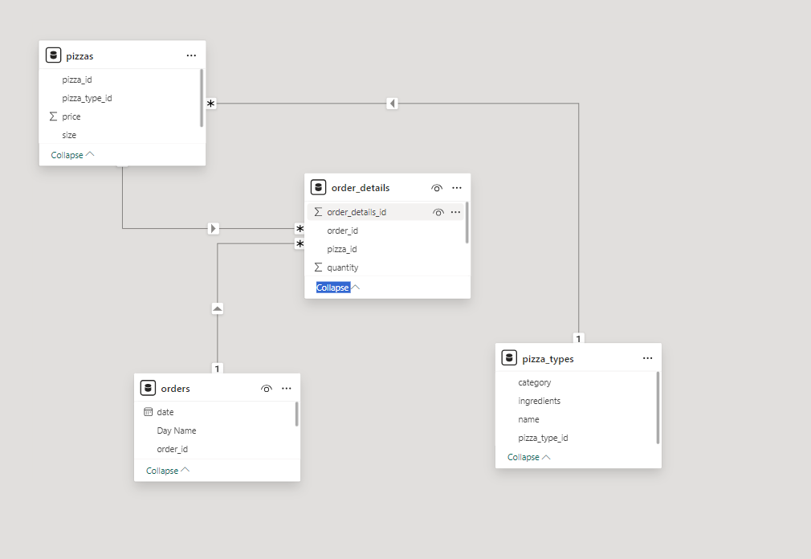
SCHEMA

Slide 5
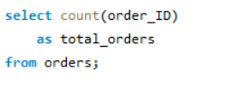
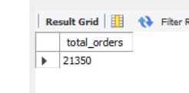
Q1 . Retrieve the total number of orders placed.

Slide 6
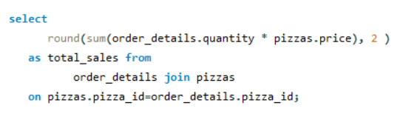
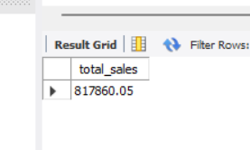
Q2 . Calculate the total revenue generated from pizza sales.

Slide 7
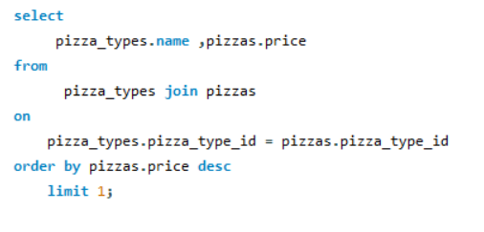
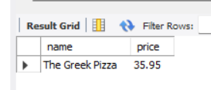
Q3 . Identify the highest-priced pizza.

Slide 8
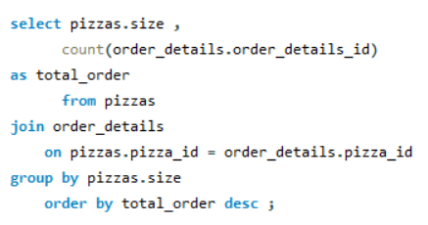
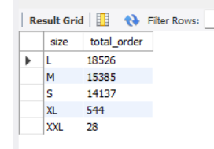
Q4 . Identify the most common pizza size ordered.

Slide 9
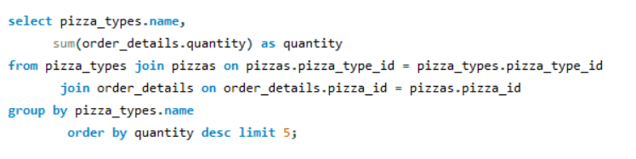
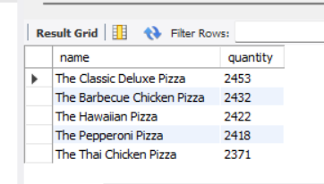
Q5. List the top 5 most ordered pizza types along with their quantities.

Slide 10
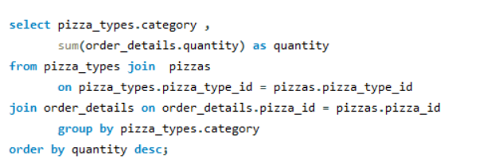
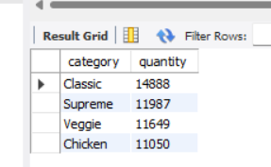
Q6. Join the necessary tables to find the total quantity of each pizza category ordered.

Slide 11
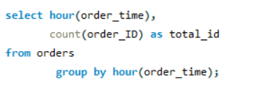
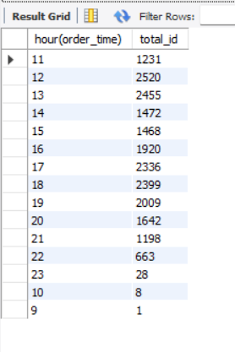
Q7. Determine the distribution of orders by hour of the day.

Slide 12
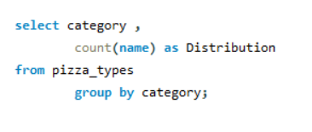
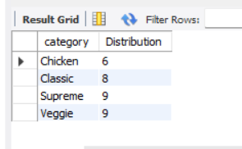
Q8. Join relevant tables to find the category-wise distribution of pizzas.

Slide 13
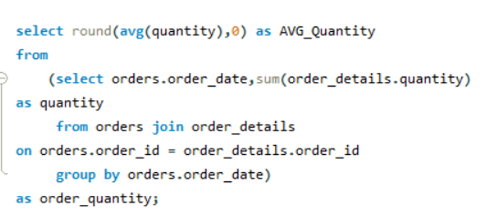
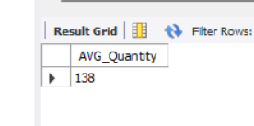
Q9. Group the orders by date and calculate the average number of pizzas ordered per day.

Slide 14
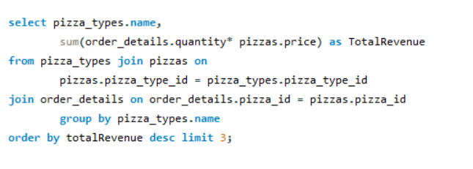
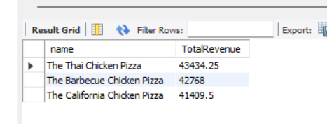
Q10. Determine the top 3 most ordered pizza types based on revenue.

Slide 15
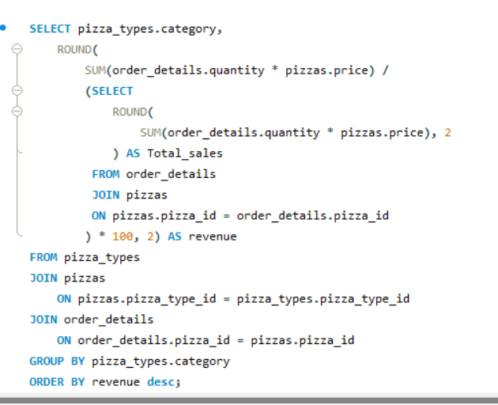
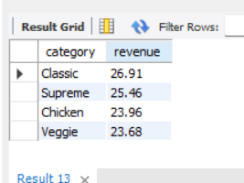
Q11. Calculate the percentage contribution of each pizza type to total revenue.

Slide 16
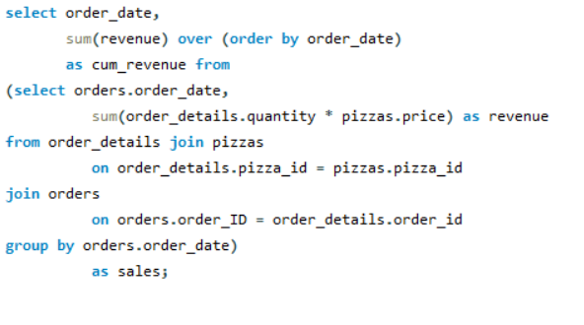
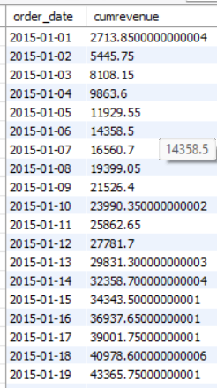
Q12. Analyze the cumulative revenue generated over time.

Slide 17
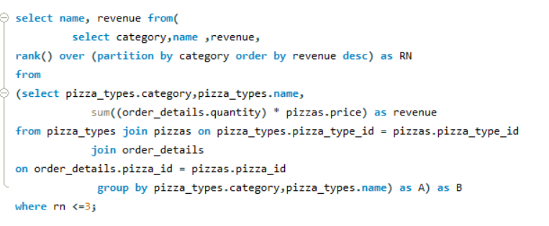
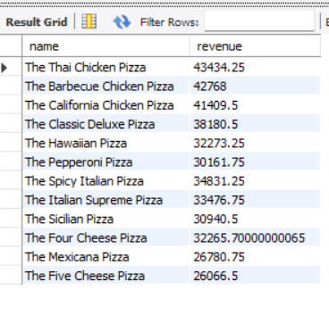
Q13. Determine the top 3 most ordered pizza types based on revenue for each pizza category.

